Slide 1


Text Classification Twitter Sarcasm Detection
Group Name – Sarcasm Experts
Artsiom Strok astrok2@illinois.edu
Peter Zukerman
peterz2@illinois.edu
Dheeraj Patta (Captain)
npatta2@Illinois.edu
CS410 Text Information Systems - Competition

Slide 2

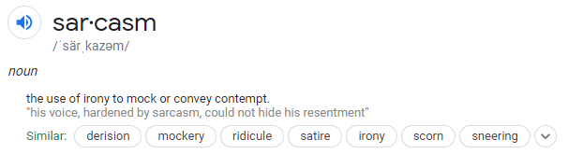
The Problem Statement
Classify a given sequence of tweets (responses) as sarcastic or not sarcastic.
The objective of this competition is to predict the “label” of the response (tweets) using the given context (either immediate or full context)
The tweets are provided with conversation context which is an ordered list of dialogue. The responses are the tweets to be classified.

Slide 3
Why Sarcasm is a hard NLP problem
Sarcasm is one of the most complex forms of figurative human expression—and therefore it’s one of the hardest to teach AI systems.
Narrow field of research in Natural Language Processing (NLP).
Specific case of sentiment analysis where focus is on sarcasm/mockery instead of polarity or sentiment in the whole spectrum.
Common challenges of Sentiment Analysis include Negations, Ambiguity, Multi-polarity and Sarcasm.
Beyond Ambiguity, to be able to interpret tone and meaning of a statement in the context of other statements is hard.
Hard for machines to understand the contradiction between literal and intended meaning.
Knowledge about the external world, environment and context is often needed to understand sarcastic comments.

Slide 4
Our Approach
Problem Statement
Understanding Data
Exploratory Data Analysis (EDA)
Data Pre-processing
Data Augmentation and Enrichment
The given twitter dataset is thoroughly examined and analyzed to understand the context and relationships like distribution, summary stats and attributes.
Classic Algorithms Modeling
Deep Learning Models
State-of-the Art Models
The processed data is utilized to train classic models at first and then deep learning models. The winning model is SOTA BERT model.
Feedback loop
Every model is evaluated using traditional metrics like Accuracy, F1, AUC, ROC curves etc. The models are hyper-parameter tuned to perform to optimum as well as large pre-trained weights are used for BERT model.
Evaluation and Metrics
Pre-trained Weights
Hyper-parameter Tuning
Iterate and improve until best results with state-of-the-art results/leaderboard rankings
Final Winning Classifier

Slide 5
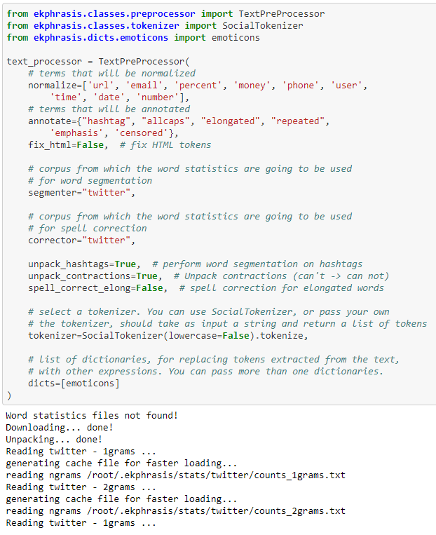
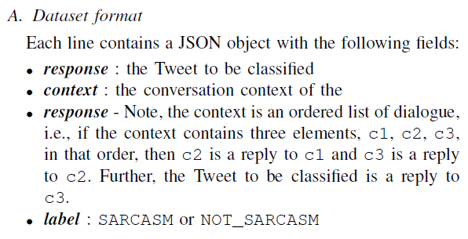
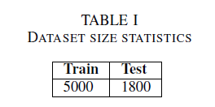
Understanding Data and Pre-processing
Basic Attributes
Pre-processing
We’ve performed the following data pre-processing steps using genism,
POS tagging,
Tokenization
Lemmatization
Label Encodings
Word Embeddings etc.
and utilized ekphrasis package to perform specialized tasks like
Social Tokenization
Text pre-processor
Word Segmentation on Hashtags
Unpack Contractions (can’t to can not),
Spell Correction and
Emoticon Analysis
* Code snippet from final BERT model

Slide 6
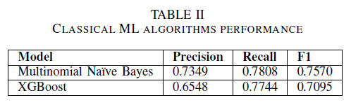
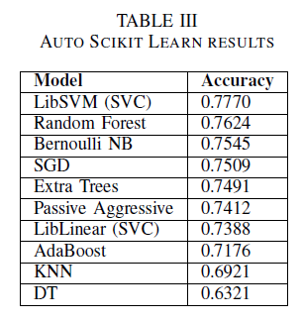
Initial Modeling (Classic)
Below is the list of classic models developed using Python’s
scikit-learn and their performance metrics.
Classic Algorithms developed –
Count Vectorizer
TD-IDF Transformer
Multinomial Naïve Bayes
Stochastic Gradient Descent (SGD)
Boosting Algorithms developed –
Gradient Boosting (GB)
XG Boosting (XGB)
Validation Mechanism -
K-fold stratified cross validation
Source Code
https://github.com/dheerajpatta/CourseProject/blob/main/models/sarcasm_classification.ipynb

Slide 7
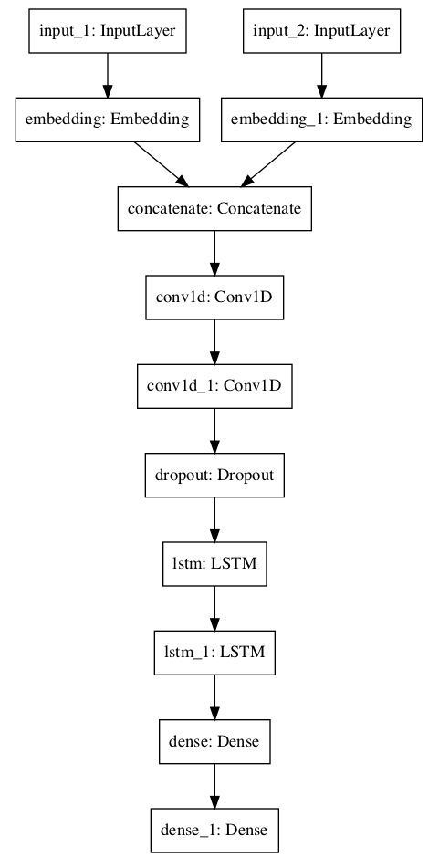
Modeling (Deep Learning Models)
We’ve developed deep learning model developed using TensorFlow and high-level abstraction framework Keras.
NLP steps -
Word Embeddings - Word2Vec, Glove (Genism)
Keyed Vectors (Genism)
Label Encodings
Deep Learning Models -
Conv 1D (CNN)
Long Short Term Memory (LSTM)
Dropouts
Dense/Hidden Layers
Evaluation Metric -
Categorical Cross-entropy
Source Code
https://github.com/dheerajpatta/CourseProject/blob/main/models/sarcasm_classification_deep_learning.ipynb

Slide 8
State-of-the-art (SOTA) Modeling - BERT
What is BERT?
BERT stands for Bi-directional Encoder Representations from Transformers. BERT is a general purpose pre-trained model that can be
finetuned on smaller task-specific datasets like sentiment analysis, question & answer system etc.
Why BERT?
BERT was revolutionary when introduced by Google. It is bidirectionally trained which means it has deeper sense of language context and flow compared to Uni-directional models.
Instead of predicting the next word in a sequence, BERT makes use of a novel technique called Masked LM (MLM): it randomly masks words in the sentence and then it tries to predict them and uses the full context of the sentence, both left and right surroundings, in order to predict the masked word. Unlike the previous language models, it takes both the previous and next tokens into account at the same time.
How BERT works?
BERT relies on Transformers (the attention mechanism that learns contextual relationships between words in a given text)
A basic Transformer consists of an encoder to read the text input and a decoder to produce a prediction for the task. The input to the encoder for BERT is a sequence of tokens, which are first converted into vectors and then processed in the neural network.
https://github.com/google-research/bert

Slide 9
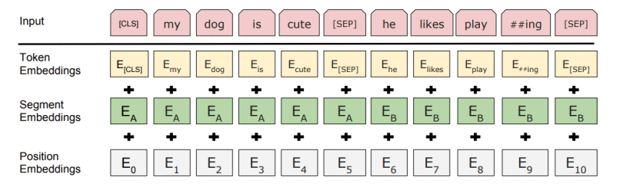
BERT (continued)
Transformer Architecture
Encoder
Feed Forward
Feed Forward
Input
Encoder – Decoder Attention
Output
Sequence of Tokens/Vectors
Self-Attention
Self-Attention
Sequence of Vectors with 1:1 correspondence
to Inputs
BERT needs the input to be massaged and decorated with some extra metadata:
Token embeddings: A [CLS] token is added to the input word tokens at the beginning of the first sentence and a [SEP] token is inserted at the end of each sentence.
Segment embeddings: A marker indicating Sentence A or Sentence B is added to each token. This allows the encoder to distinguish between sentences.
Positional embeddings: A positional embedding is added to each token to indicate its position in the sentence.
Input Embeddings = Token + Segment + Position Embeddings

Slide 10
Our State-of-the-art (SOTA) Modeling (BERT Base)
We’ve developed our BERT model using TensorFlow and high-level abstraction framework Keras. Google Colab is used to develop, train, deploy and evaluate BERT model.
BERT Model Architecture
Google’s Pre-trained BERT-Base Model
BERT-Base, Uncased
12-layers, 768-hidden-nodes, 12-attention-heads
Trained Parameters - 110M parameters
Stock Weights / Pretrained Weights.
Trained using Google Cloud NVDIA GPUs (Google Colab)
BERT Model Evaluation Metrics
Confusion Matrix
Classification Report
Accuracy, Precision, Recall, F1 score

Slide 11
Our BERT Model Implementation Explained

Slide 12
System Requirements (Installation)
All our models are in .ipynb format and can be easily replicated by using Jupyter / Google Colab or any other notebook environment.
We recommend anaconda distribution to create virtual environments for Python and recommend Google Colab for TensorFlow (TF)/Keras
Implementations.
If you want to use BERT with Colab, you can get started with the notebook "BERT FineTuning with Cloud TPUs".
To replicate our BERT model, we highly recommend downloading and using pre-trained weights.
We’ve limited our training to 15 epochs only and the model can be trained for more epochs or perform hyper-parameter tuning to achieve even better results.

Slide 13
Project Team Contributions

Slide 14
Leaderboard

